Slide 1

, Helen Jin

Slide 2
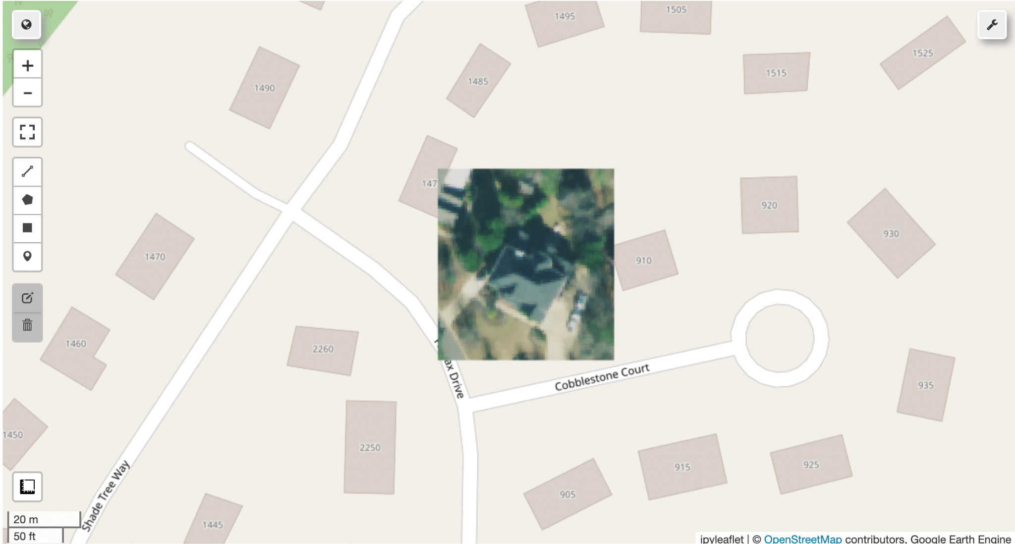
Step1: Our progess

Slide 3
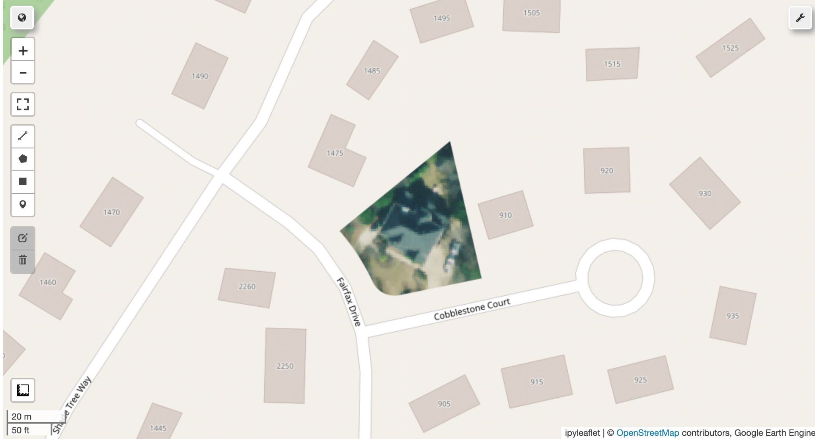
Polygon, Transparent Masking

Slide 4
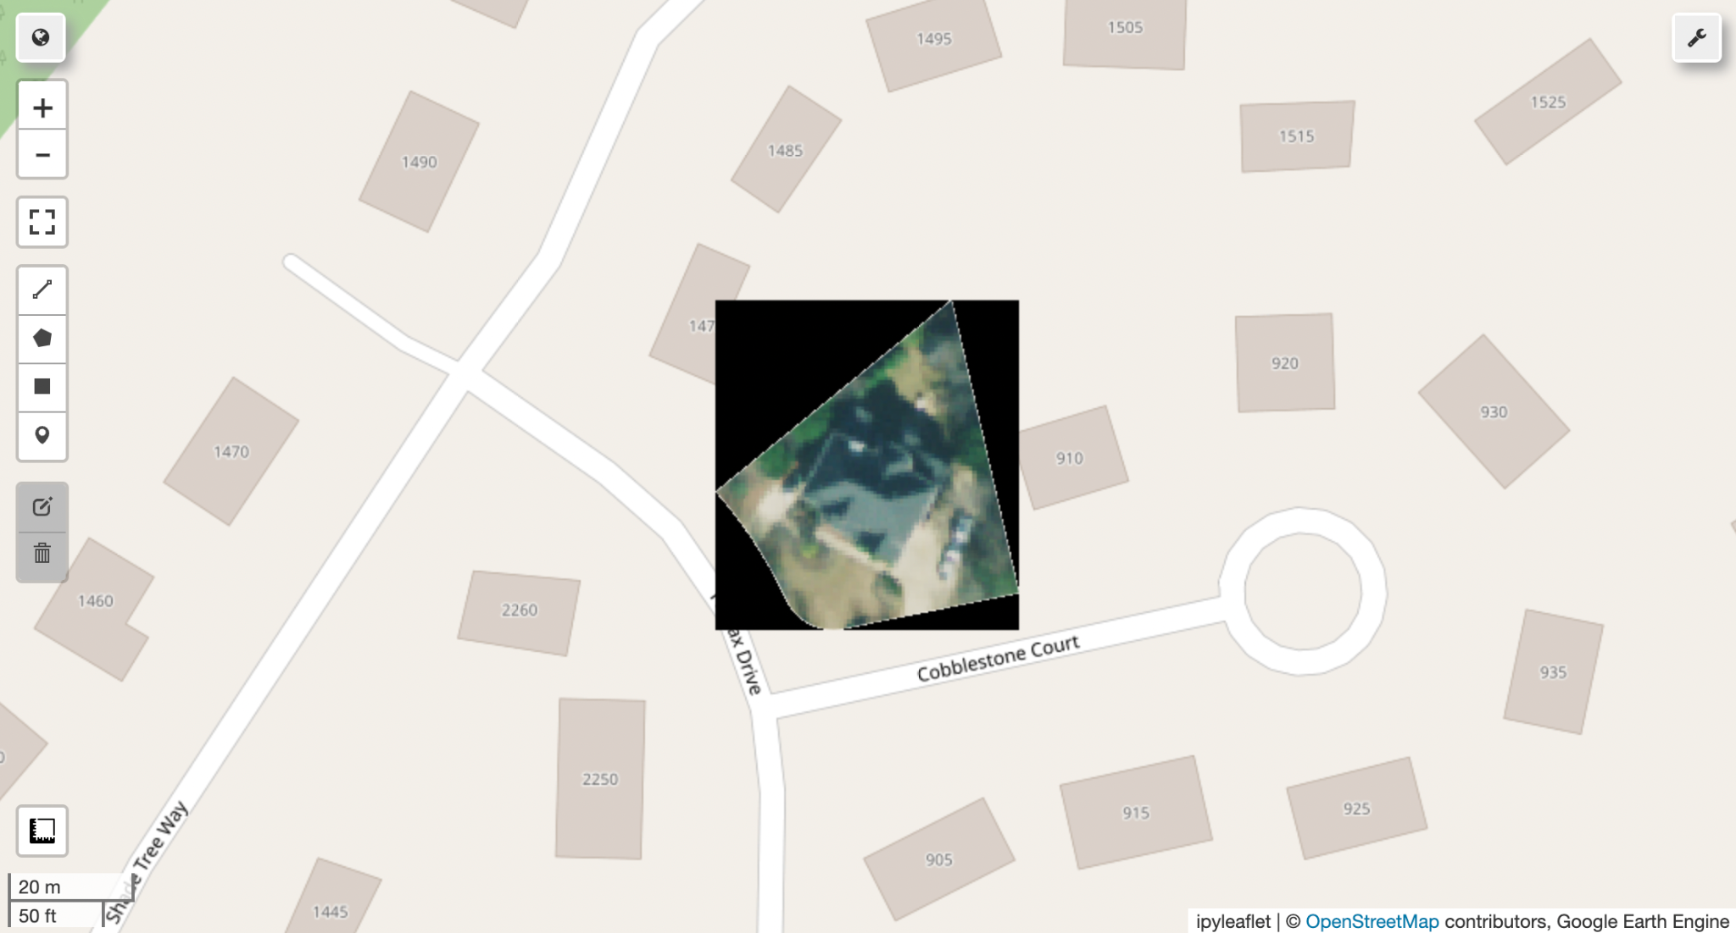
Quadrilateral with Black Masking

Slide 5

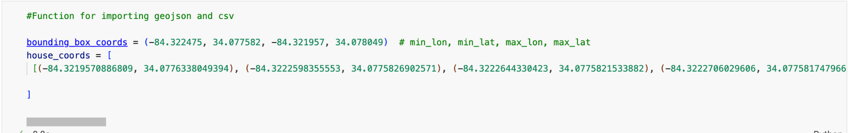

Slide 6
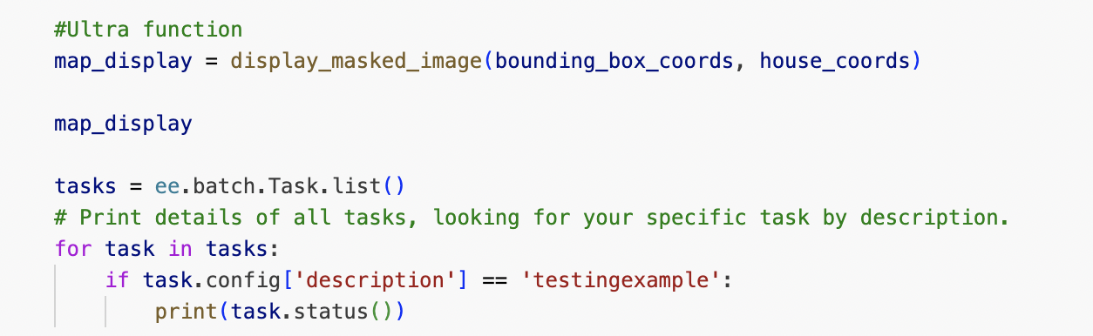

Slide 7
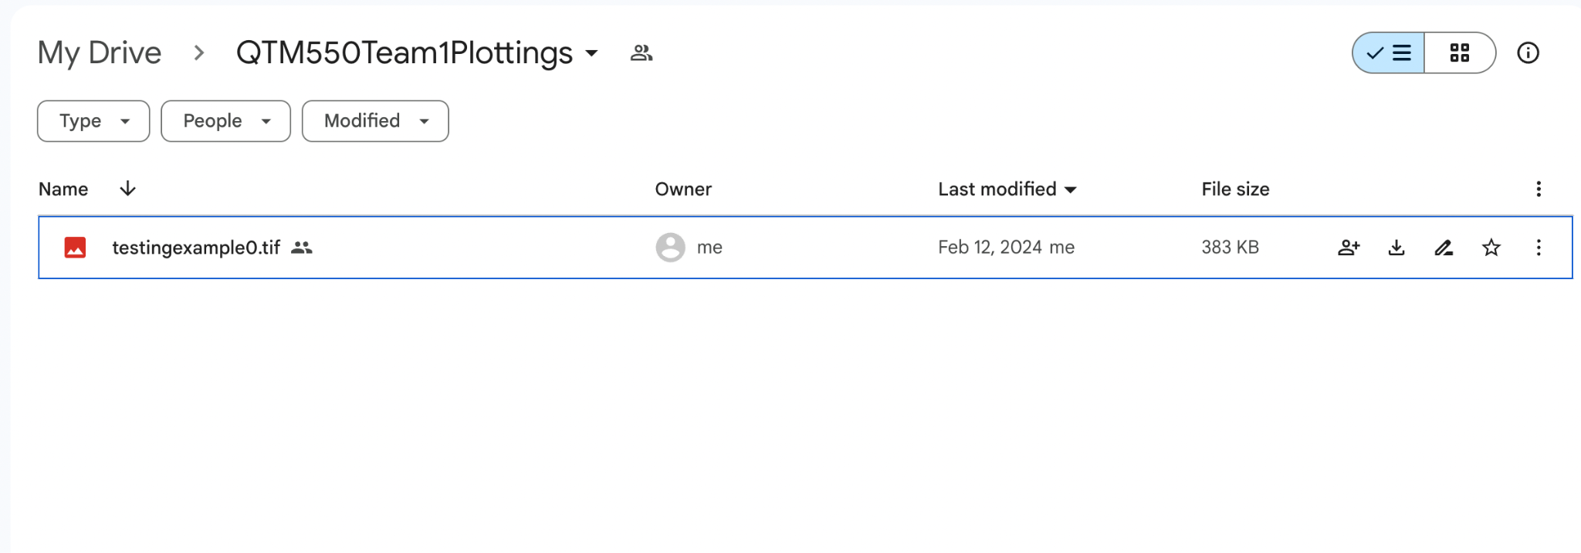

Slide 8
Step2: Parallel processes
We are going to use Multiprocessing to efficiently process the data.
GeoJSONfile(Row366264)
Break it down to 100-200 files(undecided)
3663Row
3663Row
3663Row
3663Row
3663Row
3663Row
3663Row
3663Row
3663Row
For each PC, based on the CPU cores it has, processing several amount of files
PC1
PC2
PC3
PC4
Outcome

Slide 9
Benefits of using Parallel processes
Save time as it takes forever to open the giant geojson file
Efficient
With Multiprocessing, we are running the code n times faster(depend on the amount of cores our computer have
We can run the code simultaneously on different PCs( as long as we assign them their own range of files)
https://drive.google.com/drive/folders/1rLr8n93vr7YpNuJFyuNvzrOrQvvBgtM8?usp=drive_link

Slide 10
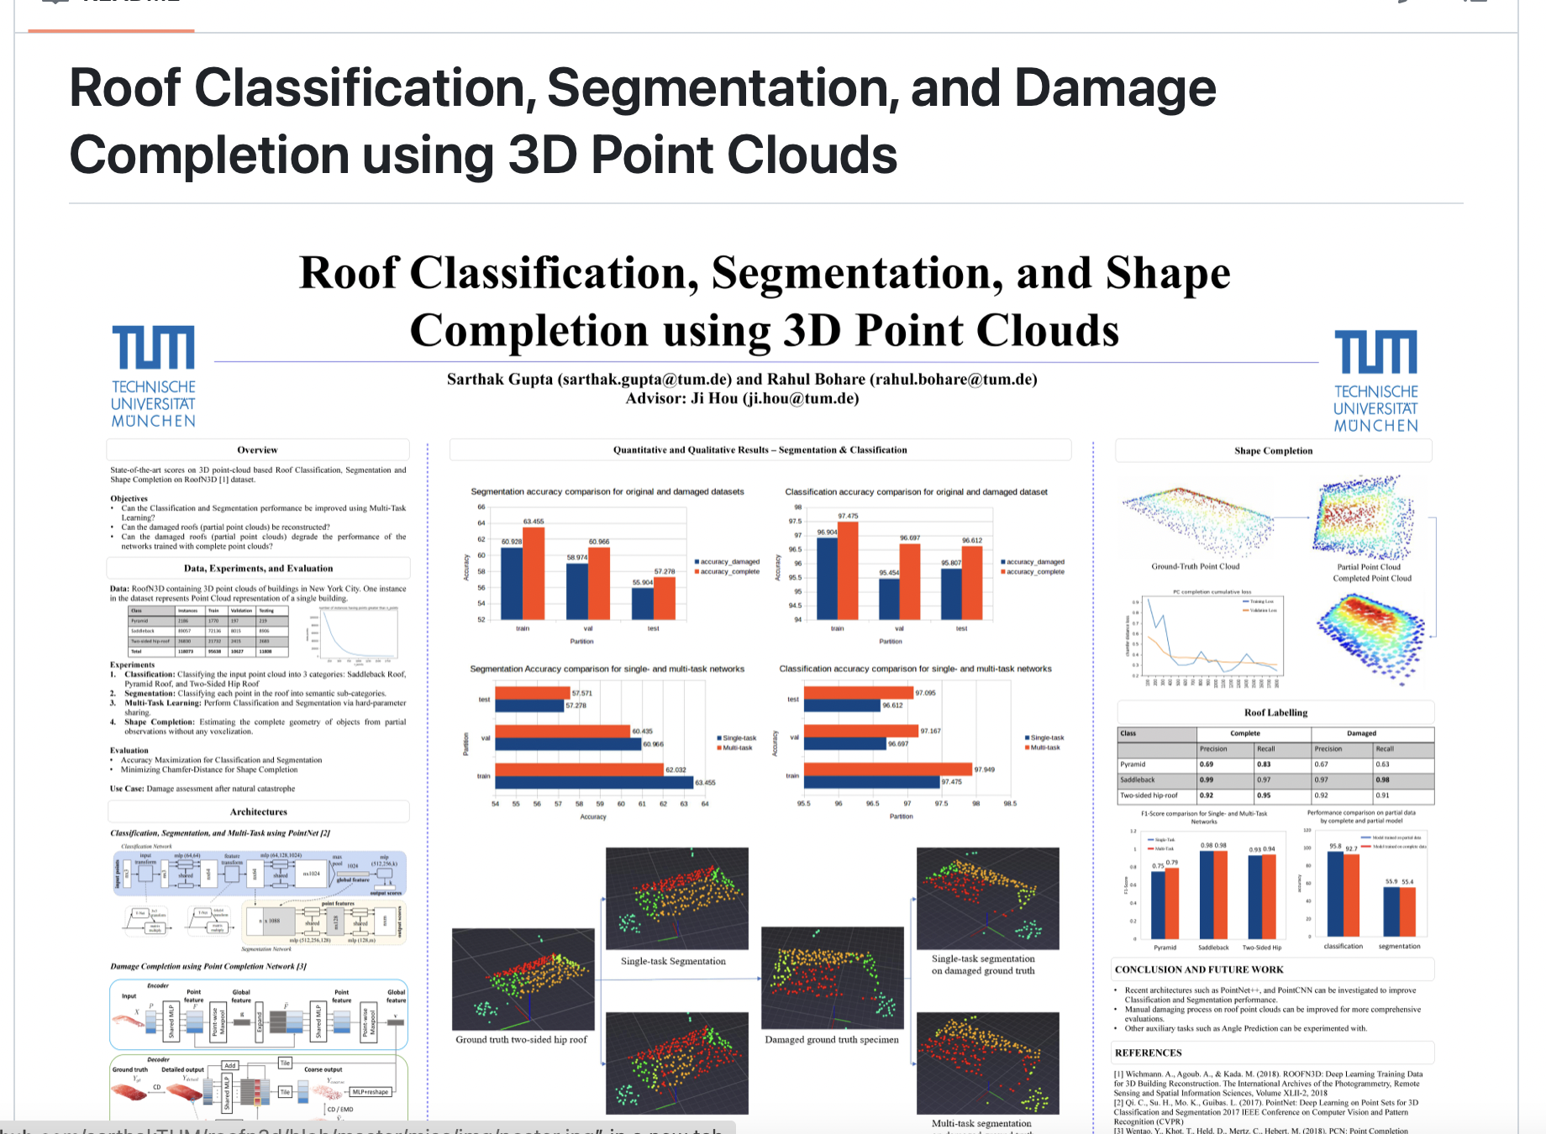
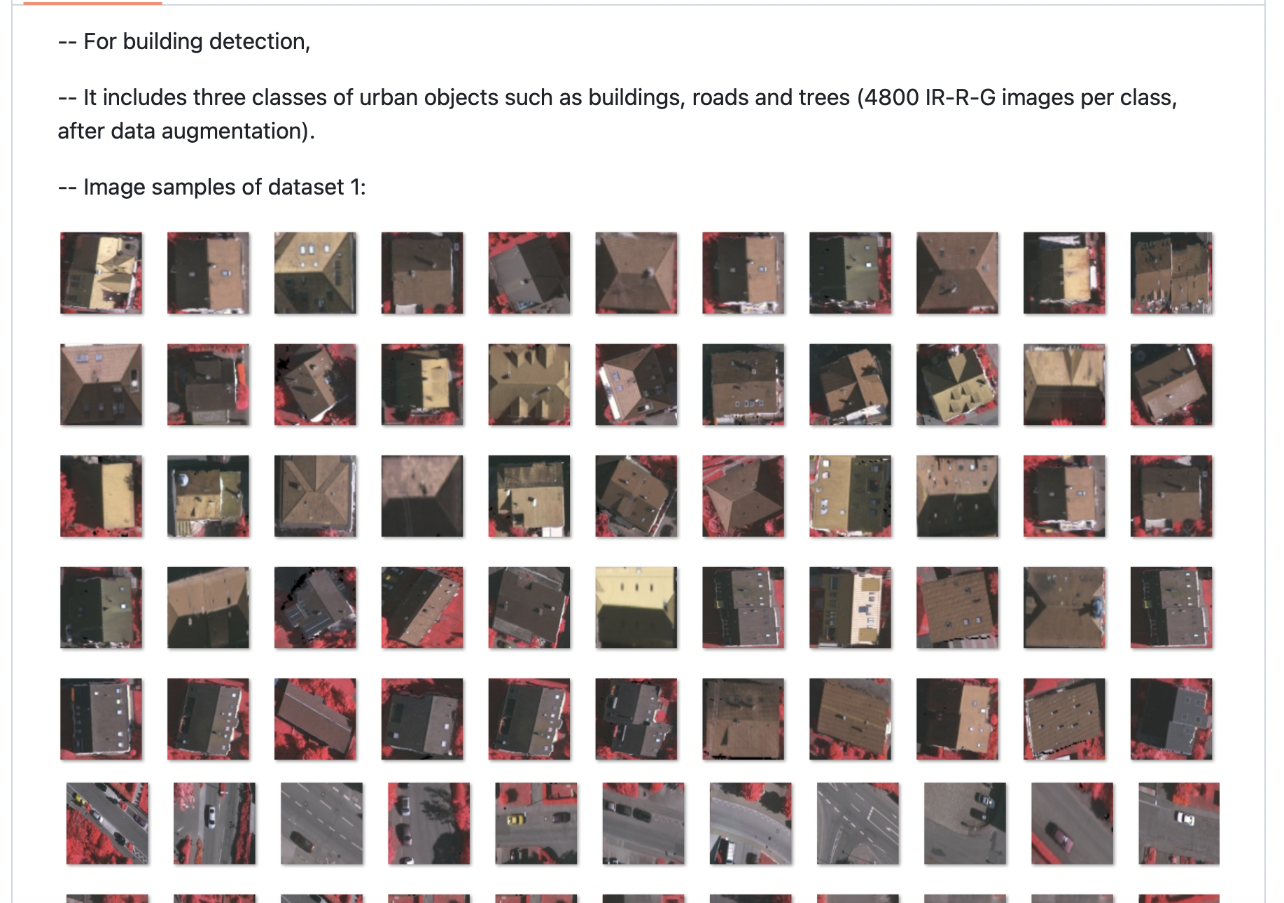
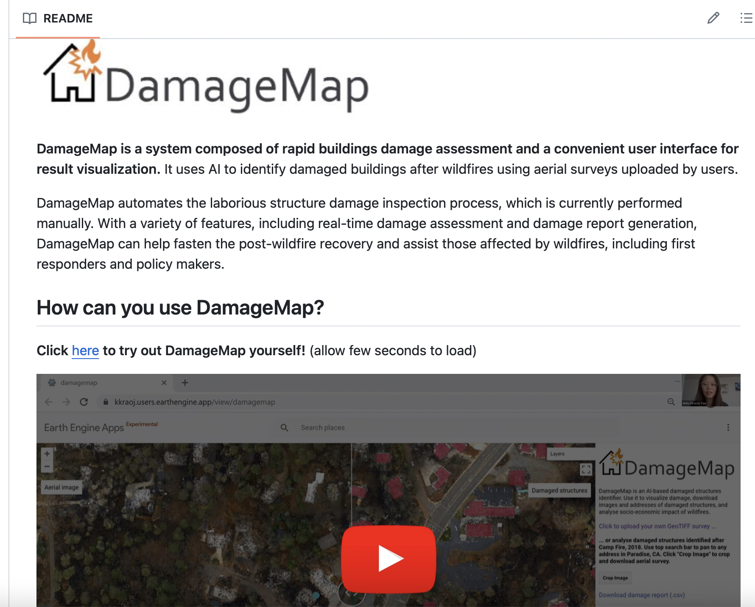
Step 3: Use Machine Learning for Image recognition
Repos that we came across:
(Building-detection-and-roof-type-recognition)
(Damaged_structures_detector)
https://github.com/sarthakTUM/roofn3d
https://github.com/loosgagnet/Building-detection-and-roof-type-recognition
https://github.com/kkraoj/damaged_structures_detector

Slide 11
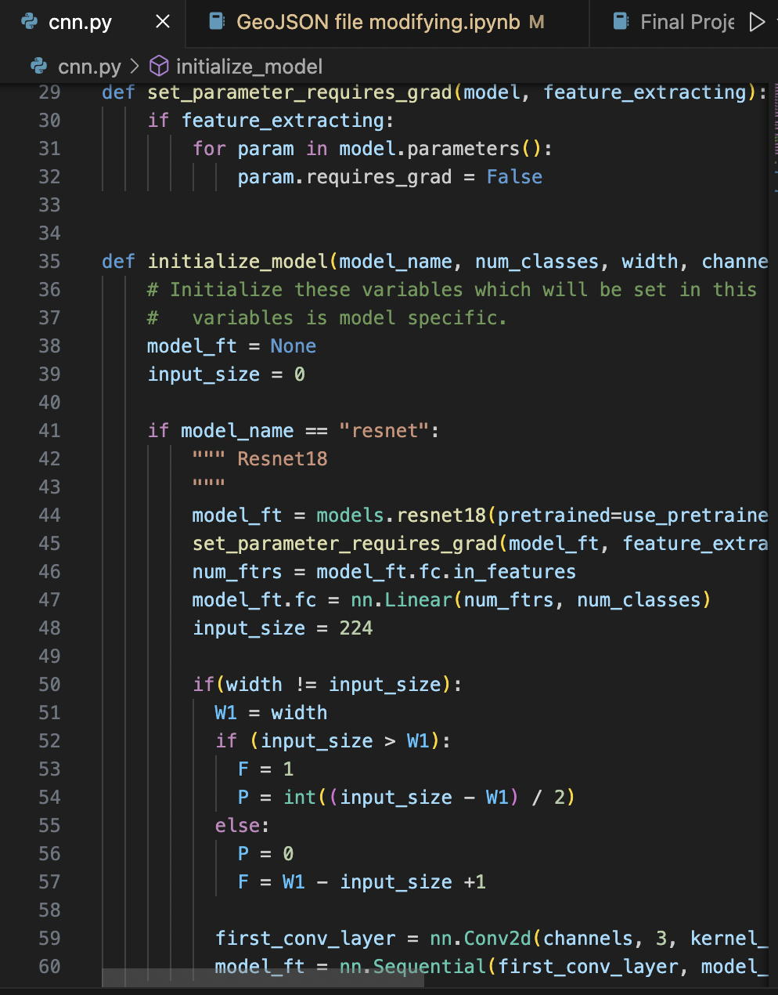
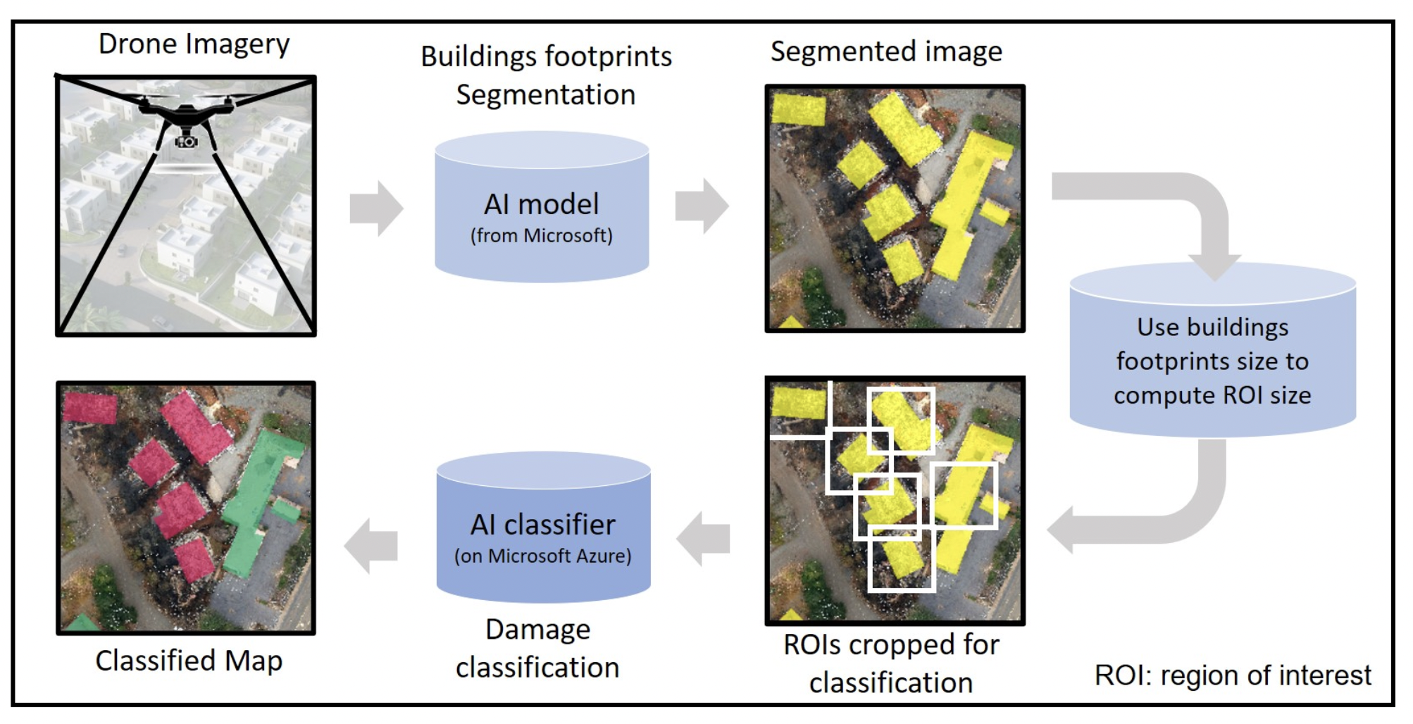
CNN
https://github.com/kkraoj/damaged_structures_detector

